Slide 1

Application and websecurity
Lab experiment – 7
Reset windows admin password

Slide 2
Lab experiment – 7
Reset windows admin password
Making a Kali Bootable USB Drive on Windows
One of the fastest method, for getting up and running with Kali Linux is to run it “live” from a USB drive. This method has several advantages:
It’s non-destructive - it makes no changes to the host system’s hard drive or installed OS, and to go back to normal operations, you simply remove the Kali Live USB drive and restart the system
It’s portable - you can carry Kali Linux in your pocket and have it running in minutes on an available system
It’s customizable - you can roll your own custom Kali Linux ISO image and put it onto a USB drive using the same procedures
It’s potentially persistent - with a bit of extra effort, you can configure your Kali Linux “live” USB drive to have persistent storage, so the data you collect is saved across reboots
In order to do this, we first need to create a bootable USB drive which has been set up from an ISO image of Kali Linux.
The specifics of this procedure will vary depending on whether you’re doing it on a Linux, macOS/OS X, or Windows system.

Slide 3
Lab experiment – 7
Reset windows admin password
Making a Kali Bootable USB Drive on Windows
What You’ll Need
1.A verified copy of the appropriate ISO image of the latest Kali build image for the system you’ll be running it on.
2. If you’re running under Windows, there is not one tool that is considered the overall best for imaging. We recommend Etcher (installer or portable) as it is simpler to use, however Rufus is another popular option with its advance options. If one does not work for you, consider the other.
3. A USB drive, 8GB or larger (Systems with a direct SD card slot can use an SD card with similar capacity. The procedure is identical.)
Note :
During this procedure, you might see some warnings telling you that Kali Linux contains malware, trojan, virus or whatever. This message usually comes from Windows Defender or USB Defender, or a third-party antivirus. Those warnings are expected: Kali Linux is packed with pentesting tools that are likely to be flagged as malware. Just ignore the warnings

Slide 4
Lab experiment – 7
Reset windows admin password
Making a Kali Bootable USB Drive on Windows
1. Plug your USB drive into an available USB port on your Windows PC, note which drive designator (e.g. “G:\”)
it uses once it mounts, and launch Rufus.
2. With Device, check the dropdown list of options for the USB drive (e.g. “G:\” and size).
3. Boot selection needs to point to point to the Kali Linux ISO file, which can be done by clicking the SELECT button
4. Depending on your configuration, you can set the Partition scheme, as well as Target system. If you are not sure, leave it as the default values.
Note :
While you can easily create a persistent live usb with the integrated options in Rufus by increasing the persistence slider, this is not the officially supported method (check Adding Persistence to a Kali Linux Live USB Drive), as it doesn’t work for all images, like the Kali Everything Live ISO introduced in release 2022.1.

Slide 5
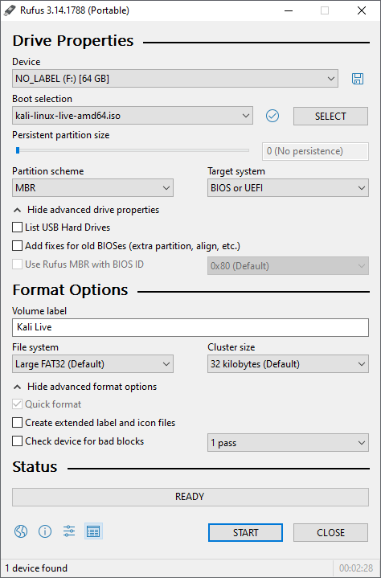
Lab experiment – 7
Reset windows admin password
Making a Kali Bootable USB Drive on Windows
5. Click the START button once ready.

Slide 6
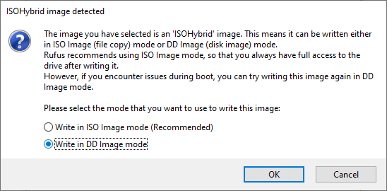
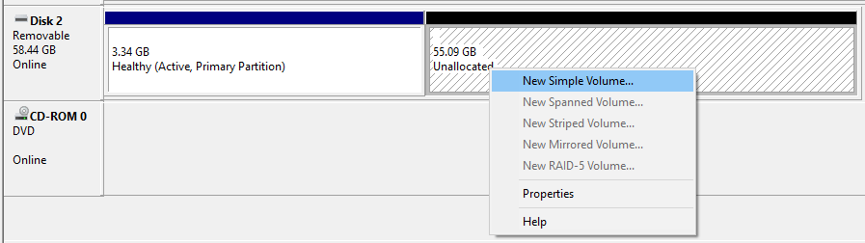
Lab experiment – 7
Reset windows admin password
Making a Kali Bootable USB Drive on Windows
6. You may get a prompt saying about ISOHybird image. Selecting ISO image, will allow you to edit the files from the Kali Linux ISO, but at the potential lose of hardware compatibility. As a result, we recommend selecting DD Image.
Note: If you select “DD Image” option, you can create another partition on the USB drive, allowing you to use the rest of the space. Start -> Run (Windows + R) -> diskmgmt.msc -> Locate the USB drive -> Right-click in “Unallocated” -> New Simple Volume -> Follow the rest of the wizard with next, next, next…

Slide 7
Lab experiment – 7
Reset windows admin password
Making a Kali Bootable USB Drive on Windows
Booting A USB Drive In Windows
Depending on the system (such as BIOS or UEFI), as well as the version of Windows, and how they are each configured, you may need to re-image the USB drive.
Master Boot Record (MBR) is often used on legacy systems that use BIOS as well as UEFI which has Compatibility Support Module (CSM) enabled
GUID Partition Table (GPT) is required where UEFI has CSM disabled, forcing to use the modern standard
After writing the image to the USB drive, reboot Windows with the USB inserted. Depending on the motherboard manufacture, will also depend on the next stage. Some motherboard’s support a “temporary” boot menu, allowing for a one off selection. Others you need to enter BIOS/UEFI to configure it to try and boot from USB first. Entering either location, also depends on the motherboard. You can look up on the manufactures website and read the manual, try and read the screen when booting (however the text may be shown too quick or full logos used), or try common key combinations (such as ESC, F1, F2, F3, F4, F8, F10, F11, F12 or DEL).

Slide 8
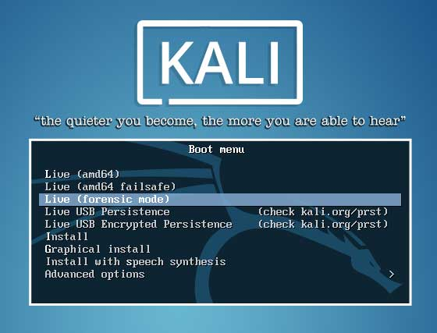
Lab experiment – 7
Reset windows admin password
Boot with Kali Linux USB
Once you have a Kali Live USB, plug it into the USB port of your Windows 10 computer and boot from the USB. You may have to press a special key (e.g., Esc, F2, F12, Del, etc.) during bootup to get the computer to boot from the USB instead of its internal hard drive.
Reset Windows 10 Local Password
1. After booting from USB, you will see Kali Linux Boot Menu. Choose the 3rd option which is Live (forensic mode).

Slide 9
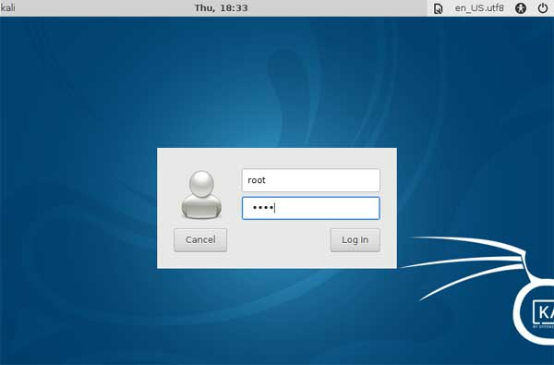
Lab experiment – 7
Reset windows admin password
2. Enter the default username as root and password as toor when prompted.
Reset Windows 10 Local Password

Slide 10
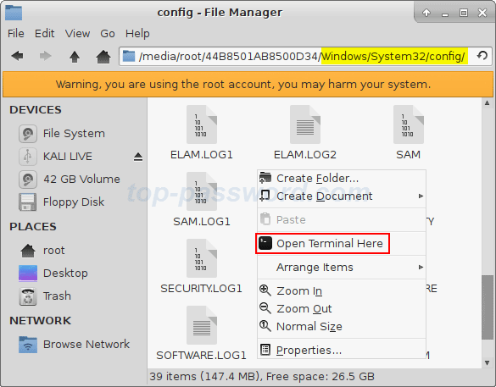
Lab experiment – 7
Reset windows admin password
3. Open File Manager and navigate to the directory where the SAM is saved. This file is usually located in /Windows/System32/Config. Right-click a blank space in File Manager, and select Open Terminal Here.
Reset Windows 10 Local Password

Slide 11
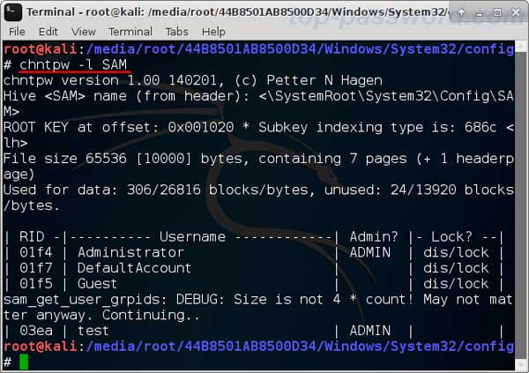
Lab experiment – 7
Reset windows admin password
4. Type the command: chntpw -l SAM. It shows the list of usernames found in the SAM on your Windows 10 OS.
Reset Windows 10 Local Password

Slide 12
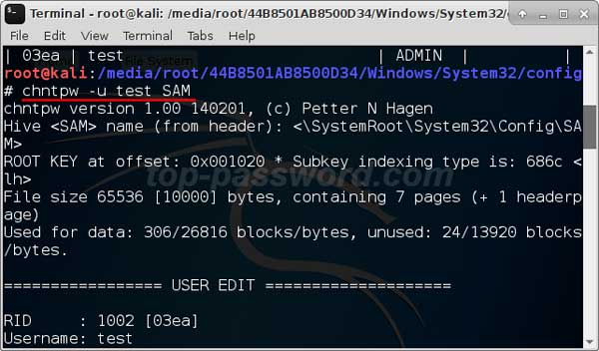
Lab experiment – 7
Reset windows admin password
5. Simply run the chntpw -u username SAM command to reset your lost password. Note: where username is the name of your actual Windows account. For example, my username is test, I should type chntpw -u test SAM after that hit Enter.
Reset Windows 10 Local Password

Slide 13
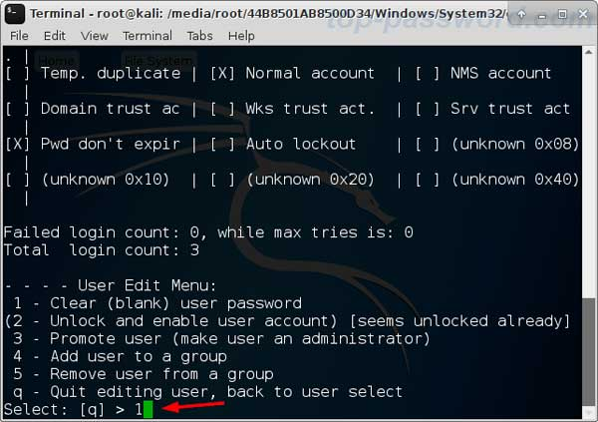
Lab experiment – 7
Reset windows admin password
Reset Windows 10 Local Password
6. Press 1 for clearing the previously set Windows password.
7. Press y when asked if you want to save the changes to the SAM hive. Now, Reboot your computer and unplug the USB drive, you will see Window 10 automatically login without password

Slide 14
THANK YOU

